Slide 1
2017 American Waters Resource
Association
Seattle
Lisa Pelly
Trout Unlimited

Slide 2
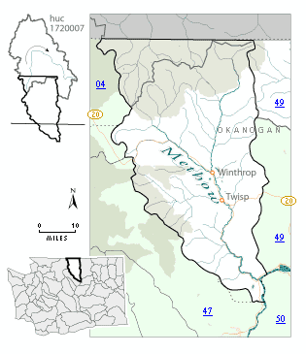
Methow Valley

Slide 3
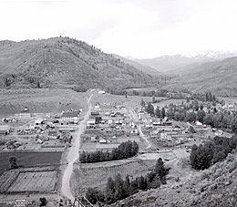
MVID-Early history
Open irrigation canals since early in the 20th century
MVID’s system included diversions from the Twisp and Methow rivers
Primarily flood irrigation during the district’s early years
Historical water right claims issued were 500 cfs from Twisp River, 150 cfs from the Methow River and a water right from Alder Creek for 2 cfs
Inefficient delivery, and becoming more so with age. Water often did not reach the lower ends of the canals

Slide 4
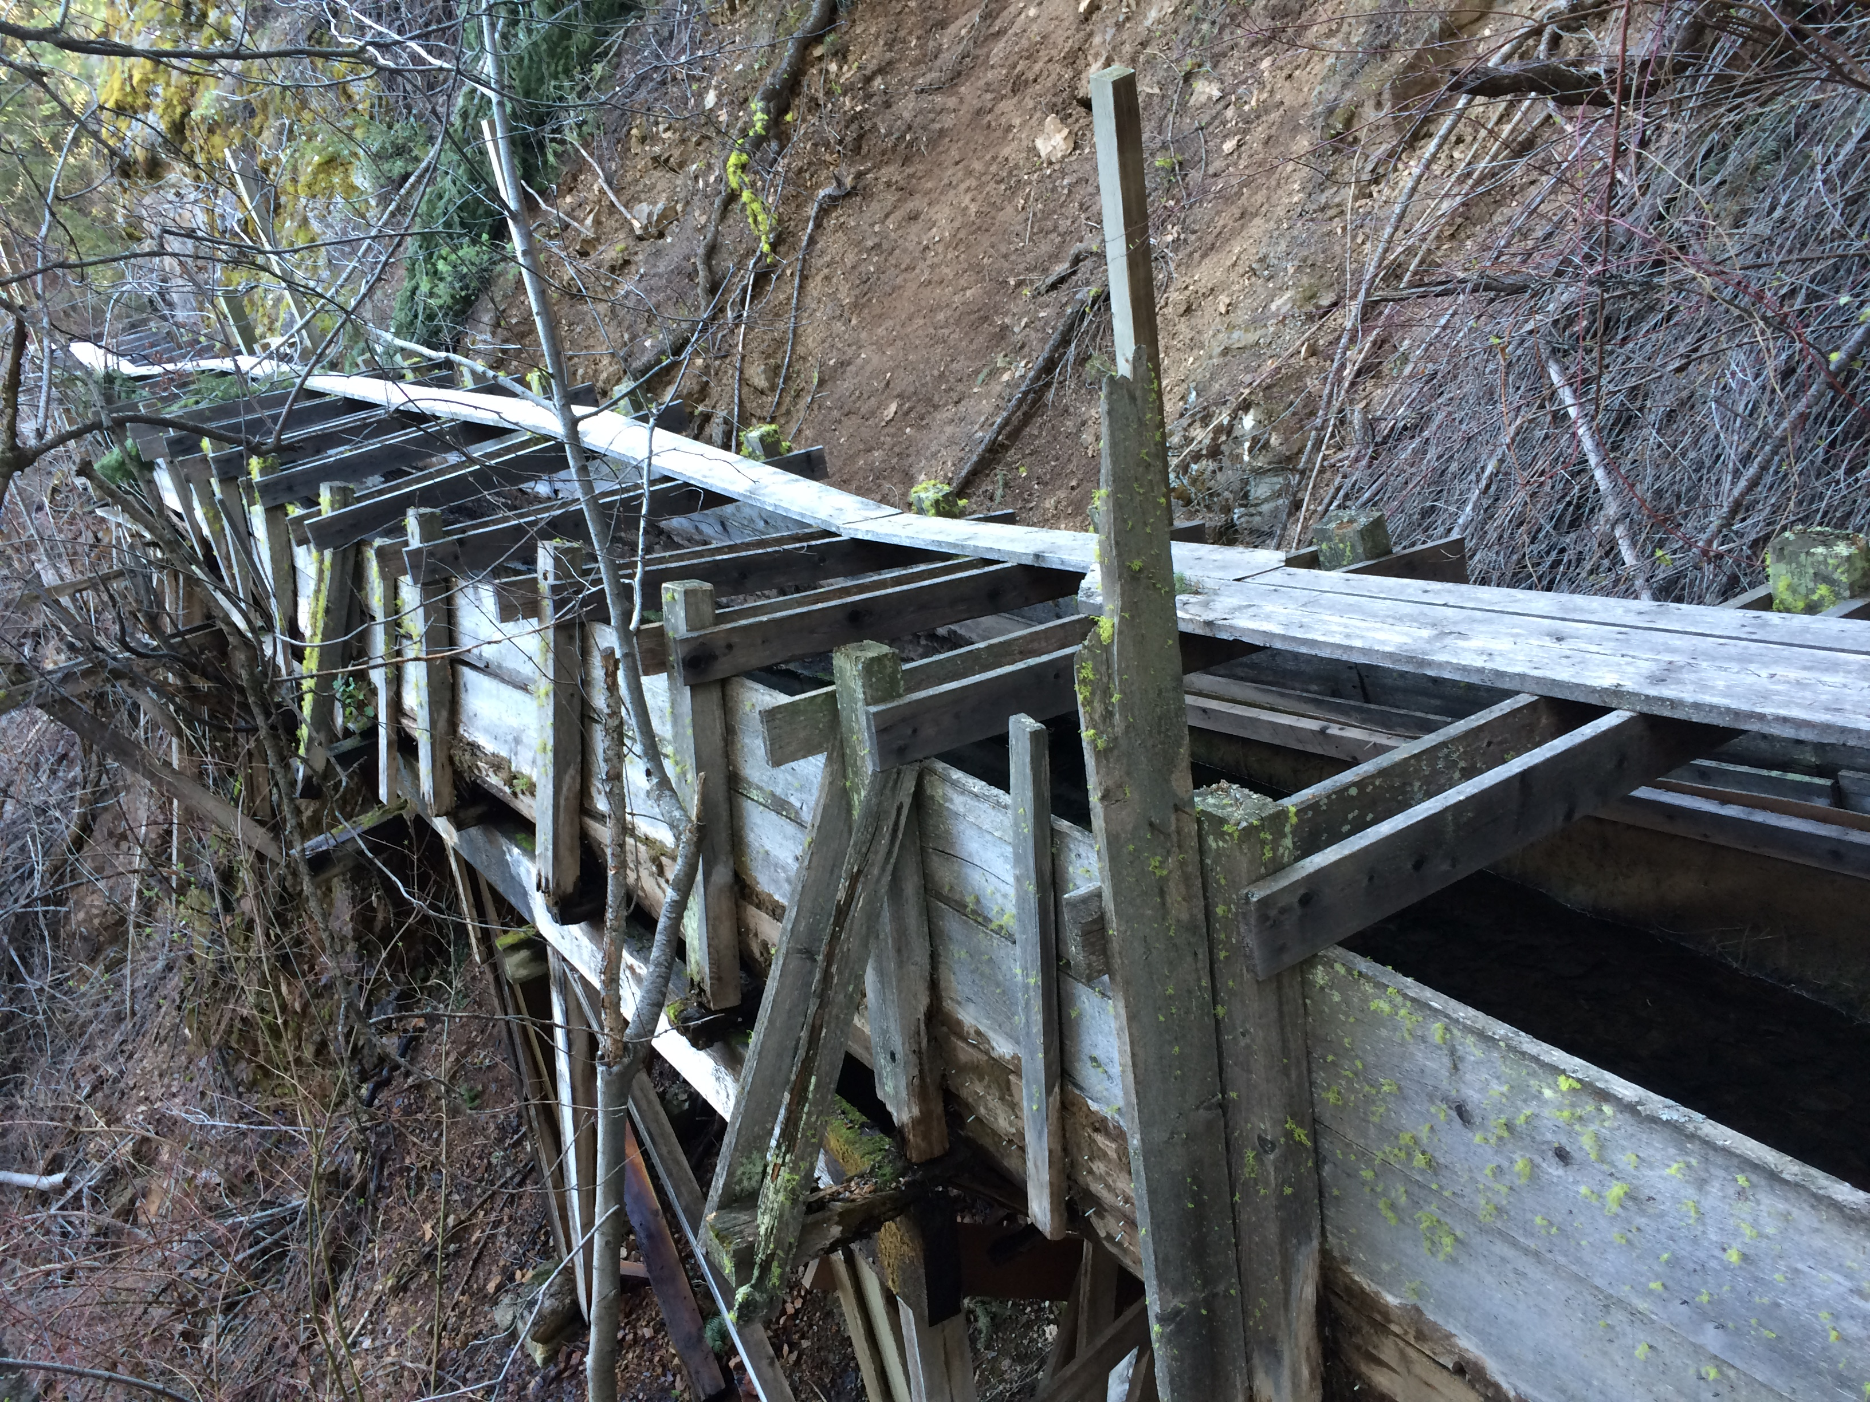
MVID-Recent History
Ecology issued two waste orders, in 2002 and 2003, imposing limits on MVID’s diversions
Following years of litigation including 4 ongoing cases in PCHB, Superior Court and Court of appeals MVID and Ecology signed a settlement agreement in 2011
20 cfs from Methow River diversion, 11 cfs from Twisp River Diversion

Slide 5
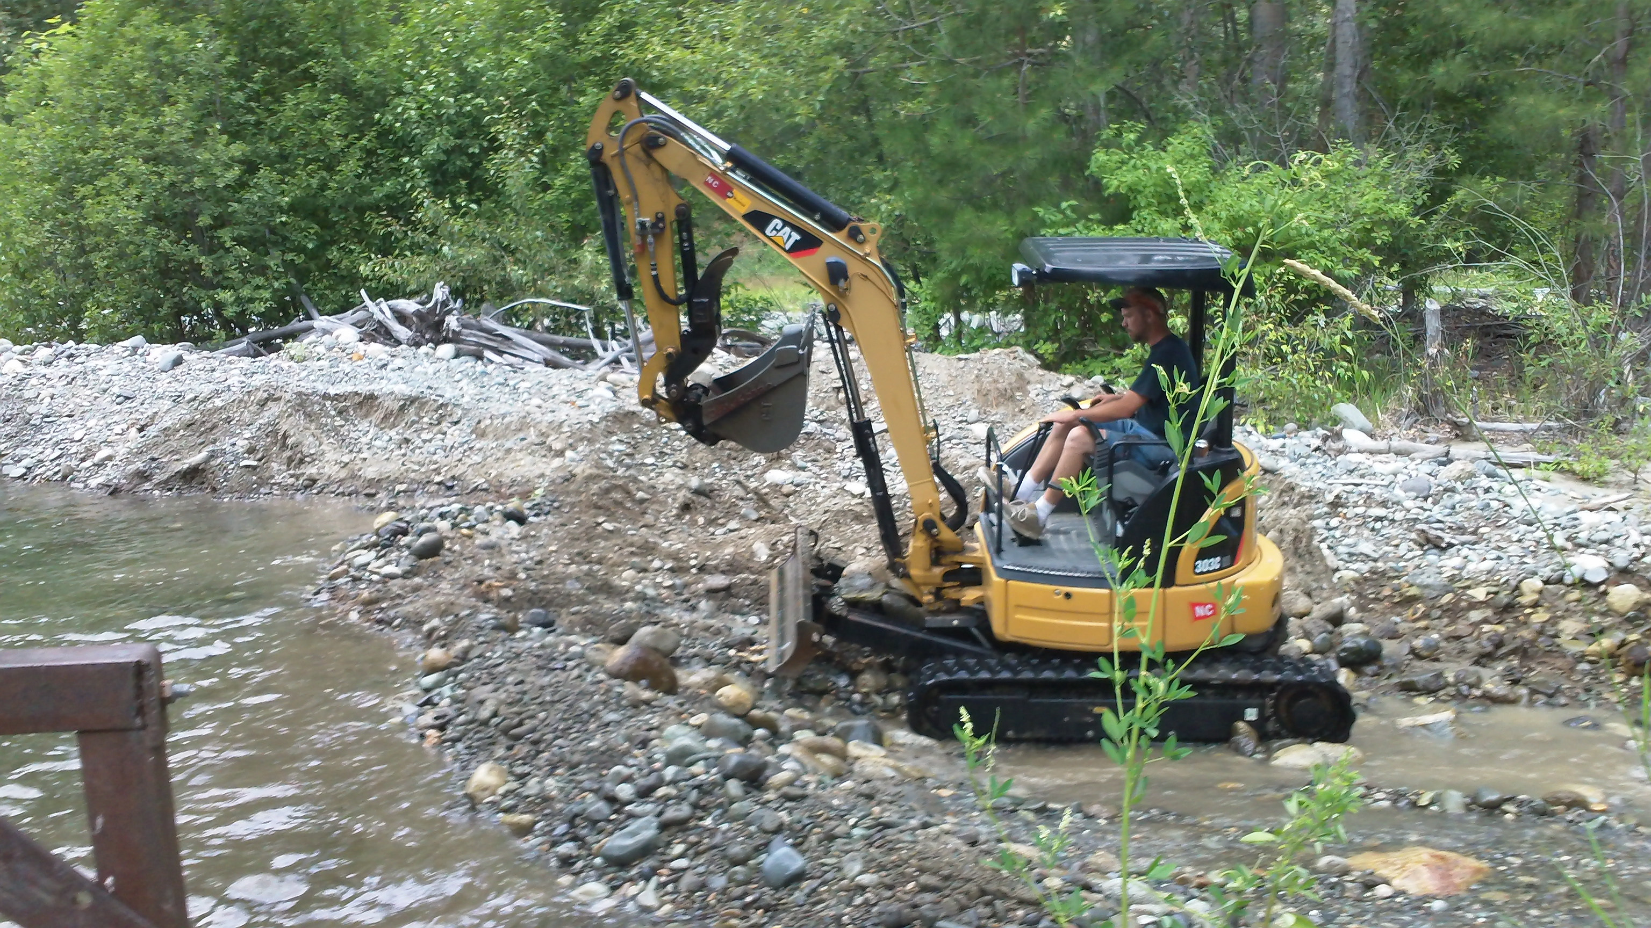

Slide 6
Town of Twisp Water Right
Twisp’s original water right dated back to 1912 from the Twisp River.
In 1948, a flood destroyed Twisp’s diversion.
Twisp received new wells in 1967 & 1971.
In 1993, Twisp applied to transfer its 1912 surface right to its wells, which was appealed by the Okanogan Wilderness League.
In 1997, Supreme Court concluded Twisp abandoned the surface rights, which reduced Twisp water rights from 610 acre-feet to 224 acre-feet.

Slide 7
Town of Twisp
  Conserved water (leak reduction, rate increases)
  Tried to buy water rights
  Investigated water re-use of wastewater
  Leased water from MVID
  Changed rate structure
  Issued temporary moratorium on new development

Slide 8
Continued Challenges
Not many water rights to buy at the top of the state due to location and season of use
Upstream transfers hard with adopted in stream flows on the Methow river
Changing a summer irrigation right (the only kind of water right available to purchase) to year-round use challenging because of impacts on winter time instream flows

Slide 9
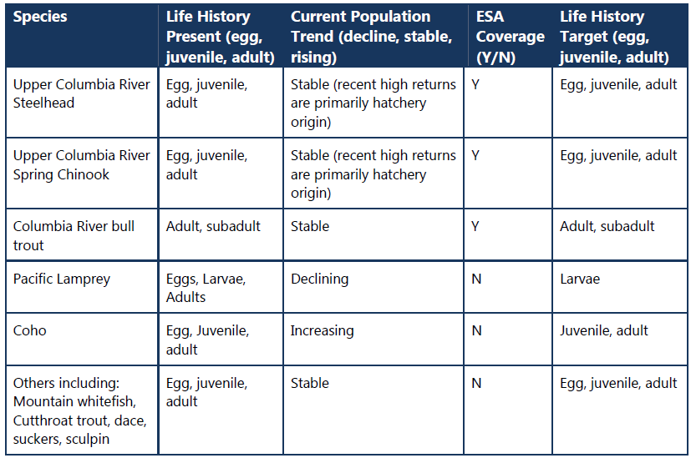
Fisheries and Insteam Flow
•

Slide 10
Project goals
  District goals
    Create a viable long-term delivery system for members who are irrigating
    Provide water to maximum number of MVID acres as possible
    Reduce risk from ESA, aging infrastructure and open canals
  Twisp goals
    20 year water supply due to water service contract with Ecology for payment of water acquisition
  Instream Flow and Fish Benefits
    Improve ecosystem function (including benefits to habitat, fish passage, water quantity, and summer instream flows) Twisp and Methow Rivers
    Eliminate injury, stranding, mortality associated with MVID normal operations

Slide 11
MIFIP ALTERNATIVE COST SUMMARY
Existing Alternatives
Alternative | Description | Cost Estimate | Notes/Assumptions
Alternative 1 | Single river pump station | $8.3 million | Continuous pipe. NO well conversions or other East side improvements
Alternative 2 | Single well(s) pump station | $8.5 million | Continuous pipe. NO well conversions or other East side improvements
Alternative 3 | Multiple wells/pump stations | $7.8 million | Dis-continuous pipe. NO well conversions or other East side improvements
Alternative 4 | North satellite well/pump system on West Canal | $7.6 million | Downsized MVID. Well conversions on both East and West. Town assumes E-1, assumes NO Airport satellite system.
Expanded Scope Alternatives
Alternative 1 | Single river pump station + East Canal Wells | $13.5 million | Town assumes E-1, assumes NO Airport satellite system.
Alternative 2 | Single well(s) pump station + East Canal Wells | $13.7 million | Town assumes E-1, assumes NO Airport satellite system.
Alternative 3 | Multiple wells/pump stations + East Canal Wells | $13.0 million | Town assumes E-1, assumes NO Airport satellite system.
Alternative 4 | North satellite well/pump system on West Canal | $7.6 million | No change-existing alternative
Alternative 5 | North satellite well/pump system on West Canal. Pressurized pipe on East Canal | $7.9 million | Town assumes E-1, assumes NO Airport satellite system. Pipe from Mill Hill to Beaver Creek.
Sources - Opinion of Probable Costs, Rice 2/25; Cost Estimate for East Pipe based on previous estimate, Nielsen; Estimate of Probable Cost for Wells , Rice,2/25

Slide 12
Project details
Piping east and west canal, well conversions, river diversion removed
11 cfs (2,854 ac-ft) savings in Twisp River, 2 cfs (360 ac-ft) in Alder Creek, reach benefits in Methow River
Seasonal transfer of consumptive use to Twisp for year-round municipal use
OCPI to cover season of use impacts (0.05 cfs)
Twisp 20-year growth due to
Right-sizing of MVID
District waterbank

Slide 13
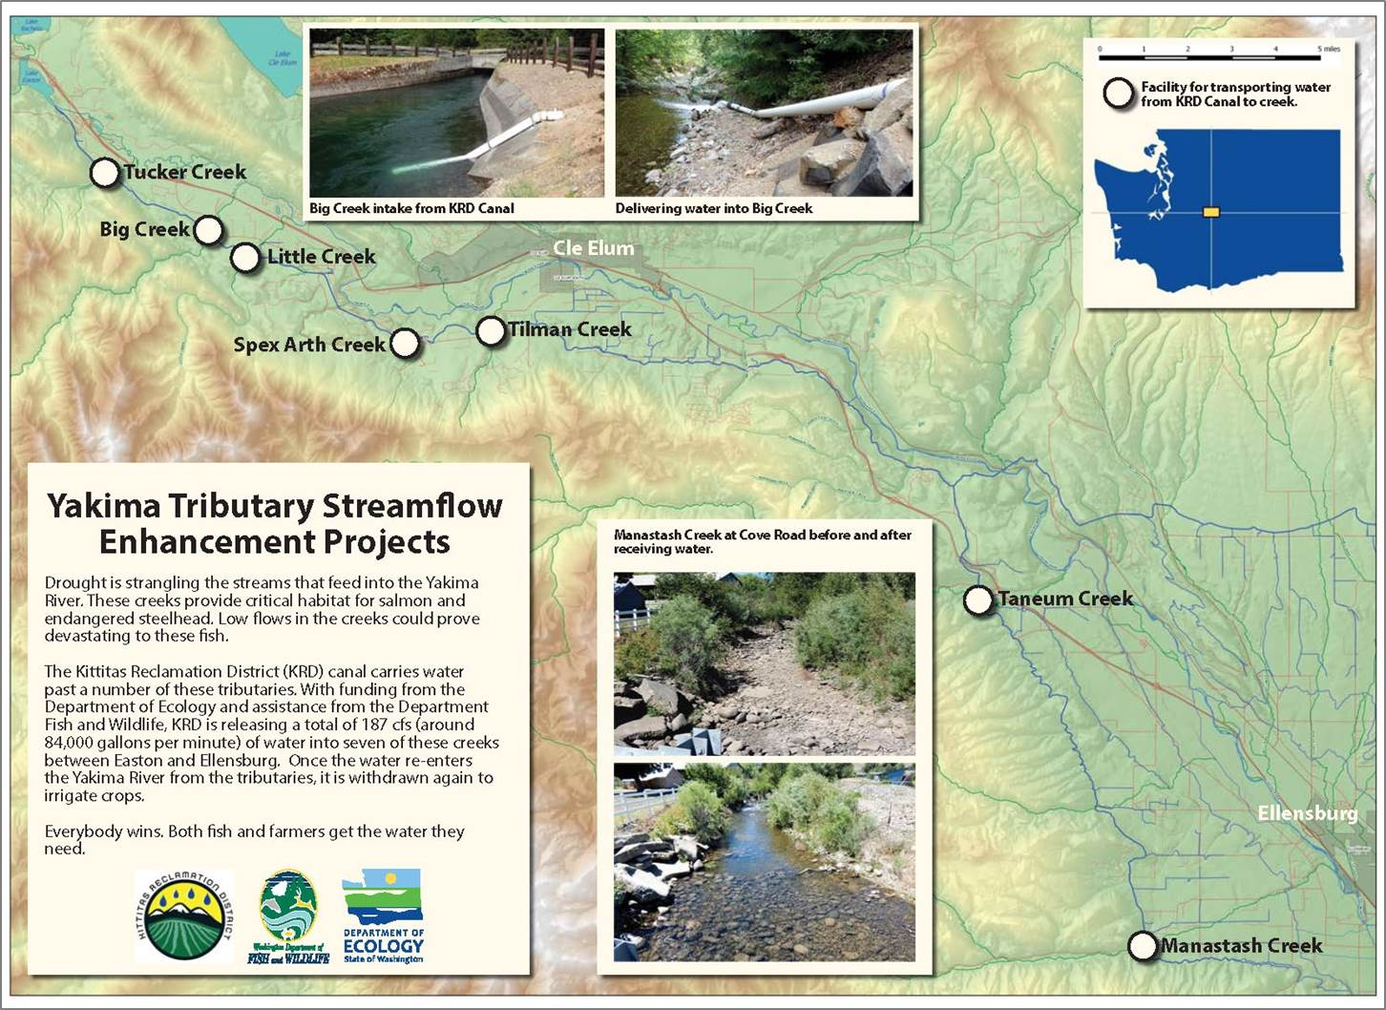
Enhanced Water Conservation:
KRD Tributary Enhancement Project

Slide 14
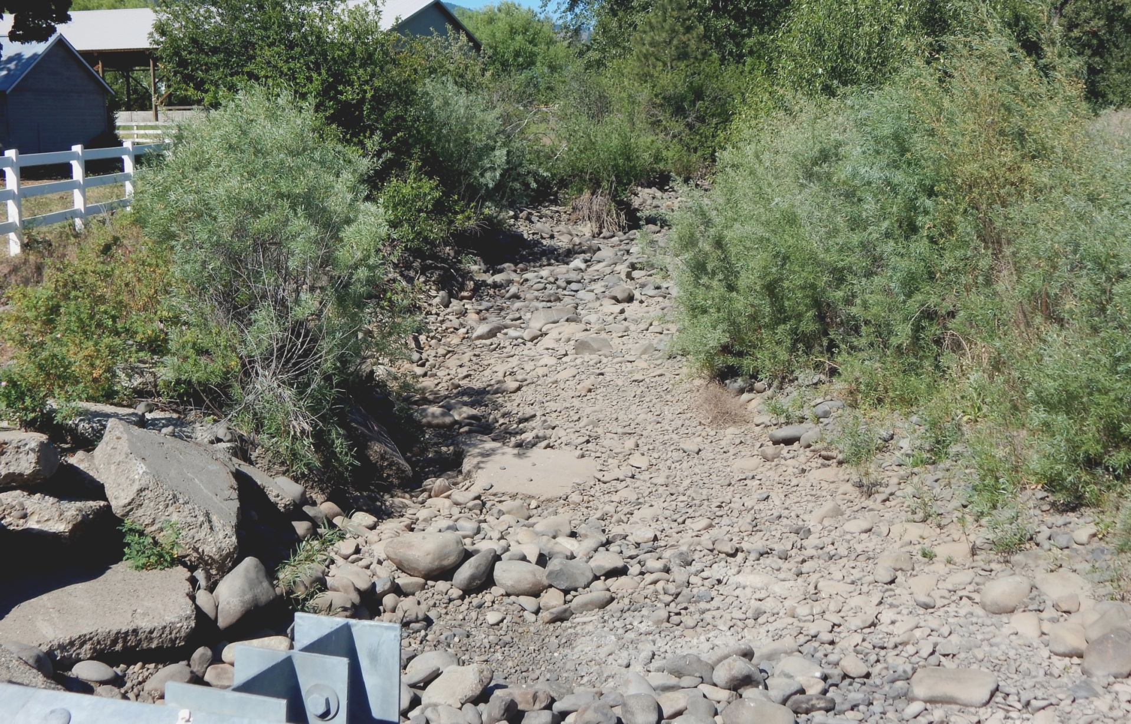
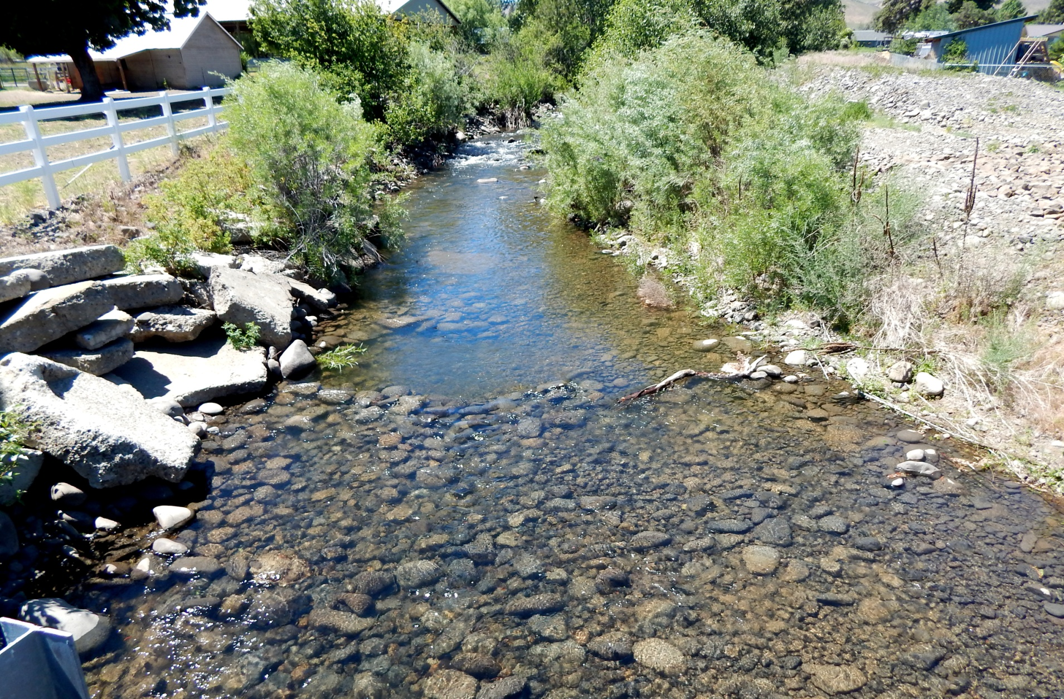
Manastash Creek -Cove Road before/after supplementation

Slide 15
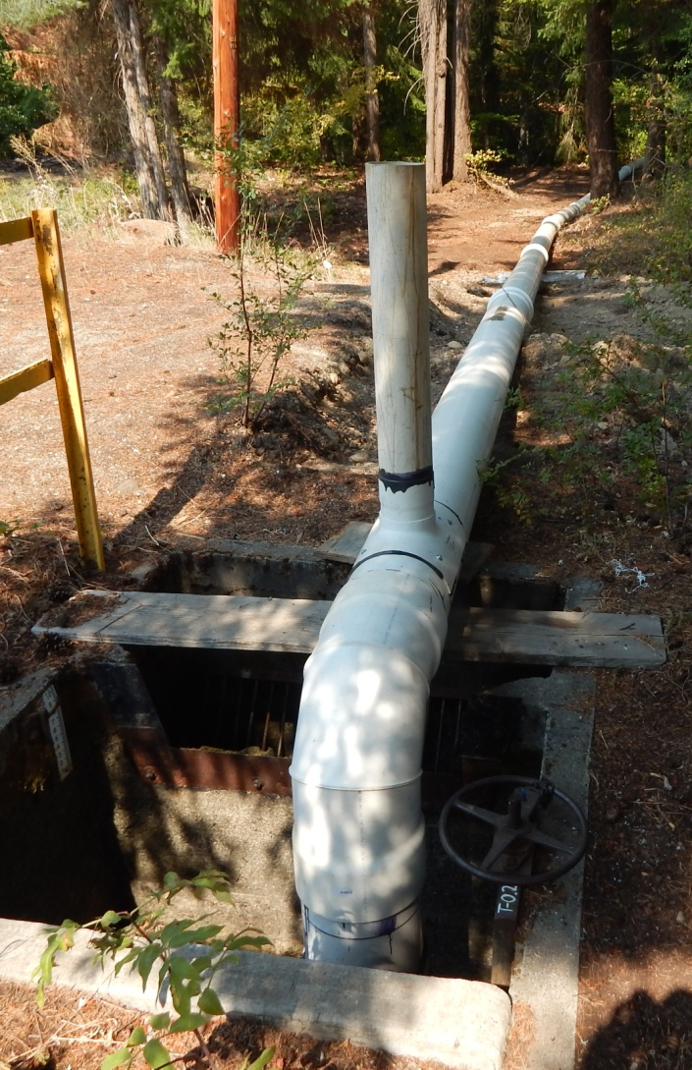
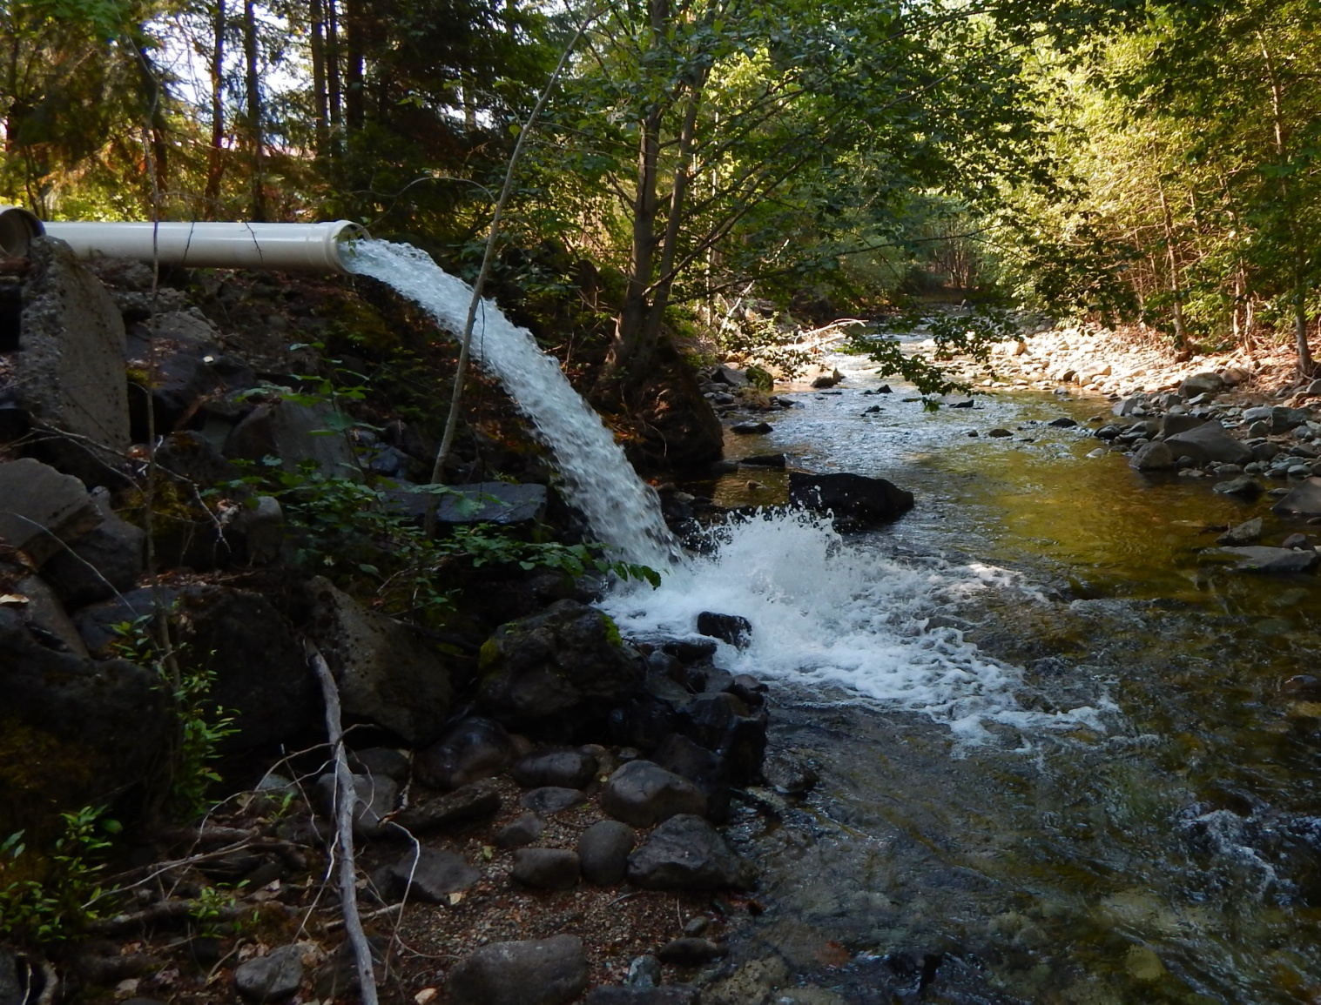
Big Creek -
Six CFS delivered through lateral and pipe

